Slide 1
6-Weeks Summer Internship on Machine Learning and Generative AI with Python

Slide 2
Week 1: Python Foundations

Slide 3
Contents
Core Python programming concepts
Variables
Data Types
User Interaction

Slide 4
Introduction to Python
Created by Guido van Rossum in 1991.
Features -
High-level
Interpreted
Object oriented
Dynamically typed
Portable
Open source

Slide 5
Reasons to choose Python
Simple elegant syntax
Not overly strict
Expressiveness of the language
Great community and support

Slide 6
Popular Python Libraries and Their Applications
Library Application
NumPy Numerical Computing and Arrays
Pandas Data Analysis and Data Manipulation
Matplotlib Data Visualization and Graphs
Seaborn Statistical Data Visualization
Scikit-Learn Machine Learning Algorithms
TensorFlow Deep Learning and Neural Networks
PyTorch AI and Deep Learning Research
OpenCV Image Processing and Computer Vision

Slide 7
Why Python is Used in AI & Machine Learning?
Simple and Easy to Learn: Easy-to-read syntax , Less code compared to other languages , Faster development and prototyping
Powerful AI/ML Libraries: NumPy, Pandas, Scikit-Learn, TensorFlow, PyTorch, OpenCV.
Cross-Platform Compatibility: Runs on Windows, Linux, and Mac OS, Easily integrates with cloud platforms
Rapid Development: Helps build AI models quickly , Ideal for research, experimentation, and deployment

Slide 8
Real-World Applications of Python in AI
ChatGPT and Generative AI
Face Recognition Systems
Self-Driving Cars
Recommendation Systems (Netflix, Amazon, YouTube)
Fraud Detection
Medical Diagnosis
Voice Assistants

Slide 9
Python Installation
Install python from the official website (https://www.python.org)
Download the latest stable version.
Install python and enable “Add Python to PATH”.
Verify installation using:
python --version

Slide 10
Using Google Colab
Google Colab is a cloud based Python programming platform.
No installation required
Programs run directly in the browser
Useful for:
i. Practice programs
ii. Machine Learning
iii. Data Science
iv. GPU-based execution

Slide 11
Steps to Use Google Colab
Open Google Colab
Sign in using Gmail account
Click on New Notebook
Write Python code in cells
Press Shift + Enter to execute code

Slide 12
Introduction to GitHub
GitHub is a cloud-based platform used to store and manage code.
It helps developers collaborate on projects.
It keeps track of changes made to files.
It acts as an online portfolio for programmers.
Why Do Companies Use GitHub?
Version Control
Code Backup
Team Collaboration
Project Management
Portfolio Building

Slide 13
Assignment Submission Through GitHub
Step 1: Create GitHub Account
Step 2: Create Repository
Repository Name: StudentName_ML_Internship_2026
Step 3: Organize Folder Structure
StudentName_ML_Internship_2026
├── Week1
│ ├── Exercise1.py
│ ├── Exercise2.py
├── Week2
├── Week3
└── Final_Project
Step 4: Upload Files
Upload Python files (.py)
Upload Google Colab notebooks (.ipynb)
Add comments in code / Use meaningful filenames

Slide 14
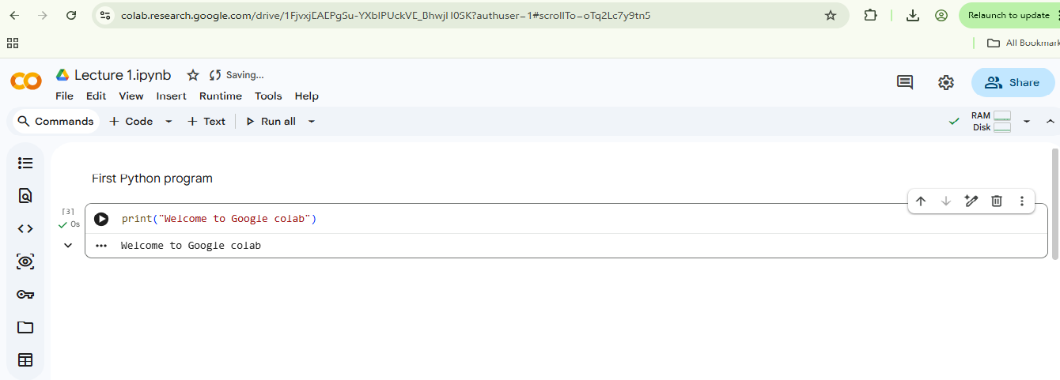
First Python Program
To print a welcome message using Google colab.

Slide 15
Exercise:
Print your name on the screen.
2. Print: Your name, Your college name , Your city
3. Print any motivational quote.

Slide 16
Points to Remember
To represent a statement, newline is used.
Use of semicolon is optional
Instead of curly braces { }, indentations are used to represent a block.

Slide 17
Keywords in Python
Keywords are reserved words in Python
They have special meaning in the programming language
Keywords cannot be used as variable names
Python keywords are case-sensitive
Common Python Keywords:
If | else | elif | for | while | break | continue | return
pass | True | False | None | and | or | not | import
from | class | def | try | except | finally | as | assert

Slide 18
Keywords help control program logic.
They are predefined by Python.
Using keywords incorrectly gives syntax errors
Exercise
Identify the keywords in the following program:
for i in range(5):
print(i)

Slide 19
Identifiers in Python
Identifiers are names given to variables, functions, classes, and objects.
They help identify program elements uniquely.
Identifiers are created by programmers
Rules for Identifiers
Must start with a letter or underscore (_)
Cannot start with a number
Cannot contain spaces
Special symbols are not allowed except underscore (_)
Keywords cannot be used as identifiers
Python identifiers are case-sensitive

Slide 20
Valid Identifiers
Name
student_age
_marks
totalAmount
Invalid Identifiers
2name
student-age
class
total amount

Slide 21
Always use meaningful names for better readability.
Follow naming conventions
Avoid very long or confusing identifiers
Exercise
Identify valid and invalid identifiers:
name1
1name
student_marks
my-name

Slide 22
Python Statement
Instructions that a python interpreter can execute are called statements.
Statements form the basic building blocks of a Python program.
Each line of code in Python is generally considered a statement
Types of Python Statements
Assignment Statements
Conditional Statements
Looping Statements
Input/Output Statements

Slide 23
Assignment Statement - Used to assign values to variables.
x = 10
name = "Rahul“
Input and Output Statements - input() takes data from user, print() displays output.
name = input("Enter your name: ")
print(name)
Conditional Statement - Used for decision making
age = 20
if age >= 18:
print("Eligible")

Slide 24
Loop Statement - Used to repeat instructions
for i in range(5):
print(i)
Multi-line Statement - Backslash \ is used to continue statement in next line
total = 10 + \
20 + \
30
print(total)

Slide 25
Exercise
Identify the type of statements:
x = 5
print(x)
if x > 0:
print("Positive")

Slide 26
Python Indentation
Most of the programming languages like C, C++, Java uses braces { } to define a block of code.
Python uses indentation.
Indentation refers to the spaces provided at the beginning of a line of code.
A code block (body of function, loop) starts with indentation and ends with the first un-indented line.

Slide 27
Example 1.
age = 20
if age >= 18:
print("Eligible to vote")
print("Program Ended")
Example 2.
age = 20
if age >= 18:
print("Eligible")
Print(“program ended”)

Slide 28
Important Points
Python usually uses 4 spaces for indentation
Same block must have same indentation
Mixing spaces and tabs should be avoided
Indentation replaces curly braces { } used in other languages
Exercise
Identify the correctly indented program:
Program 1
if True: print("Python")
Program 2
if True:
print("Python“)

Slide 29
Python Comments
Comments are used to explain the code.
Comments are ignored by the Python interpreter.
They improve code readability and understanding.
Useful for documentation and debugging
Types of Comments
Single-line Comments
Multi-line Comments

Slide 30
Single-line Comment - Single-line comments start with #
# This is a single-line comment
print("Hello Python")
Multi-line comments - Triple quotes (''' ''' or """ """) are used for multi-line comments
'''
This is a
multi-line comment
'''
print("Python Programming")

Slide 31
Python Variable
A variable is a named location used to store data in the memory.
Values stored in variables can be changed during program execution.
Python automatically determines the datatype of variables

Slide 32
Declaring variables
In python, variables do not need declaration to reserve memory space.
The variable declaration happens automatically when a value is assigned to a variable.
An assignment operator = is used to assign value to a variable.

Slide 33
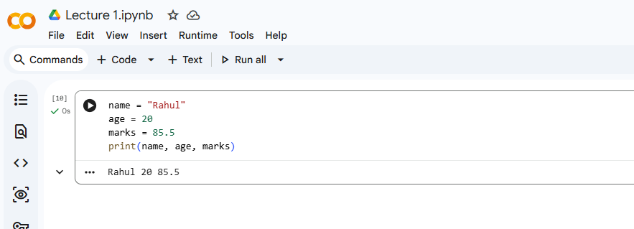
Assigning values to a variable

Slide 34
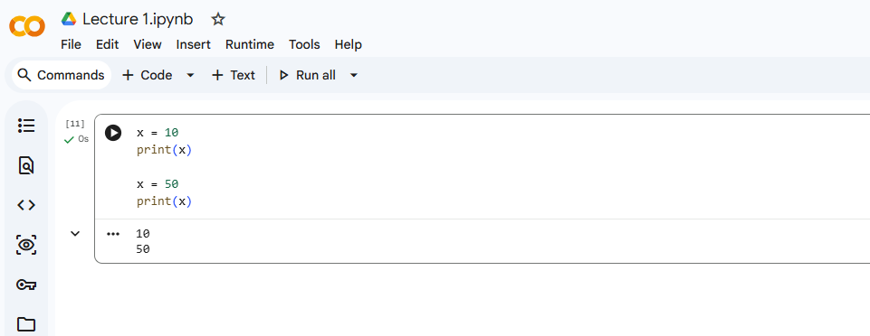
Variable Reassignment

Slide 35
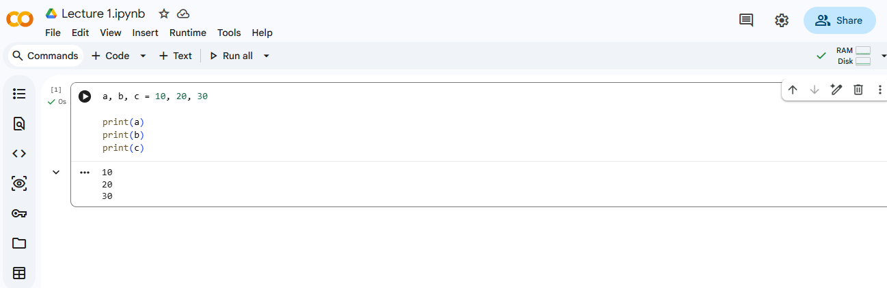
Multiple Variable Assignment

Slide 36
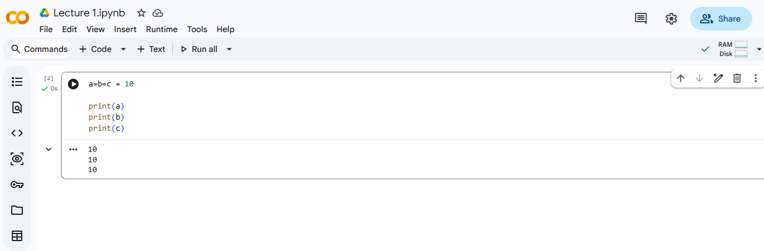
Assigning same value to multiple variables

Slide 37
Exercise
Create variables for:
Student name
Roll number
Course name
Marks

Slide 38
Constants in python
Constants are variables whose values should not change during program execution.
They are used to store fixed values.
Python does not have built-in constant support like some other languages.
By convention, constant names are written in CAPITAL LETTERS
For example
PI = 3.14159 GRAVITY = 9.8 COLLEGE_NAME = "ABC College"

Slide 39
Why Use Constants?
Makes programs easy to understand
Improves code readability
Avoids accidental changes in important values
Makes maintenance easier
Naming Convention for Constants
Use uppercase letters
Use underscore (_) between words

Slide 40
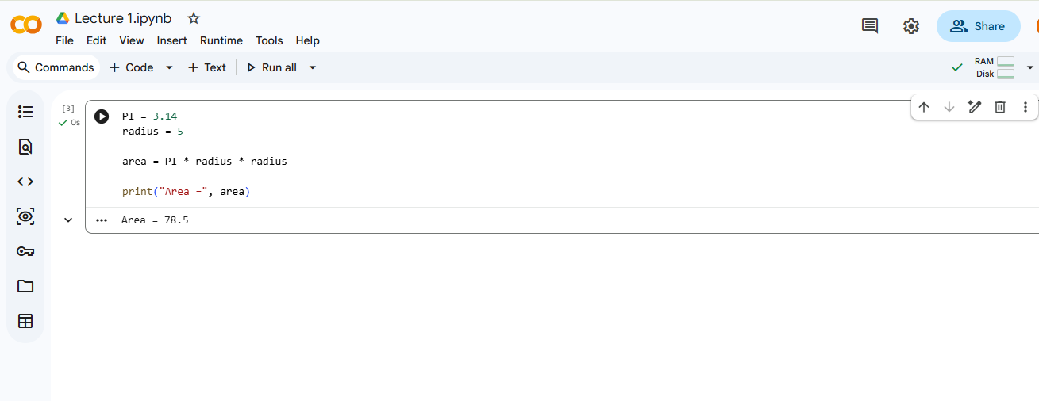

Slide 41
Exercise
Create constants for:
Value of PI
College Name
Maximum Marks

Slide 42
Literals
Literals are fixed values directly written in a program.
They represent constant values assigned to variables.
Python supports different types of literals: Numeric Literals, String Literals, Boolean Literals, Special Literal, Collection Literals.

Slide 43
Numeric literals
x = 10
price = 99.5
10 → Integer Literal
99.5 → Float Literal
String Literals
Text values written inside quotes
name = "Python"
city = 'Delhi'

Slide 44
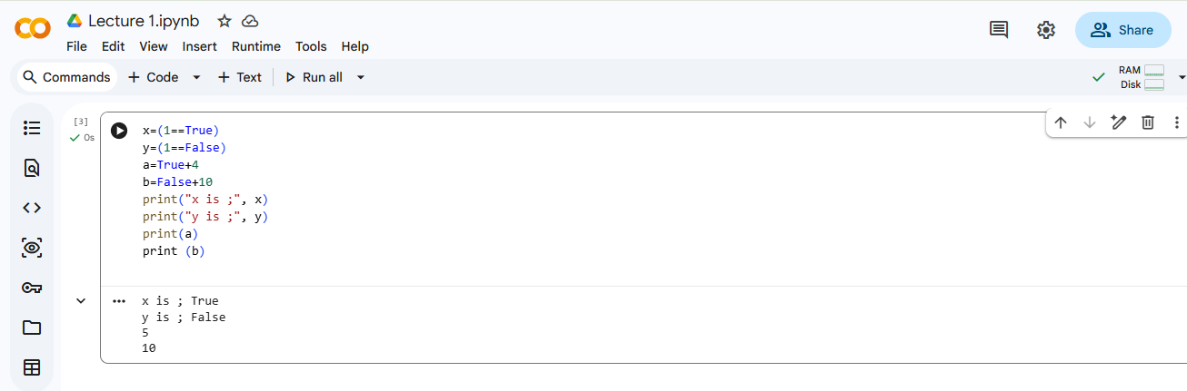
Boolean Literals

Slide 45
Special Literal
Python provides a special literal called None.
None represents the absence of a value.
It means: No data, Empty value, Null value
Example
student_name = None
print(student_name)

Slide 46
Collection literals
Collection literals are used to store multiple values together.
Types – list literal, tuple literal, set literal, dictionary literal
List Literal - A list stores multiple items in a single variable. Lists are ordered and mutable. Written using square brackets [ ]
Example,
numbers = [10, 20, 30, 40]
print(numbers)

Slide 47
2. Tuple Literal - A tuple stores multiple values. Tuples are ordered but immutable. Written using parentheses ( )
Example,
colors = ("Red", "Blue", "Green")
print(colors)
3. Set Literal - A set stores unique values. Duplicate values are automatically removed. Written using curly braces { }
numbers = {1, 2, 3, 3, 4}
print(numbers)

Slide 48
4. Dictionary Literal - Dictionary stores data in key-value pairs. Written using curly braces { }. Keys must be unique.
Example,
student = {
"name": "Rahul",
"age": 20
}
print(student)

Slide 49
Exercise
Create:
A list of 5 subjects
A tuple of 3 colors
A set of numbers
A dictionary containing student details

Slide 50
Data types
Data types specify the type of value stored in a variable.
Python automatically identifies the datatype.
Common data types in python include – integer, decimal, string, boolean, list, tuple, set, dictionary.

Slide 51
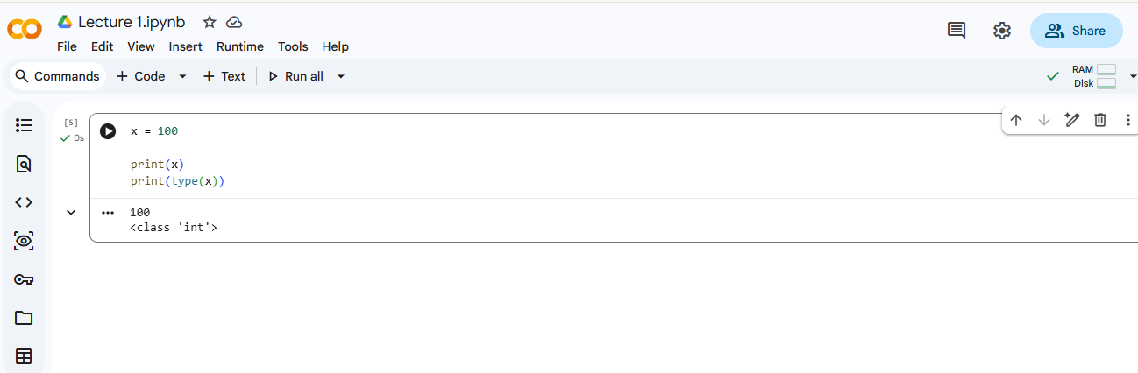
Integer (int) Data Type

Slide 52
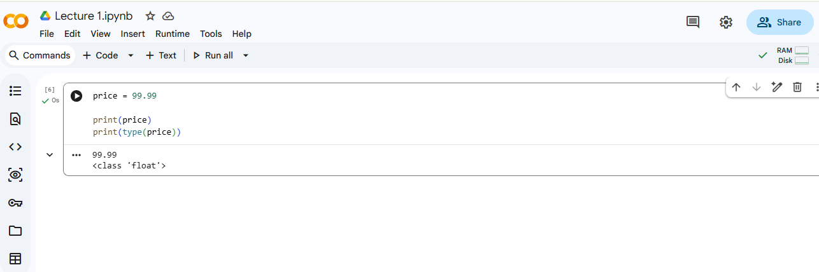
Float (float) Data Type

Slide 53
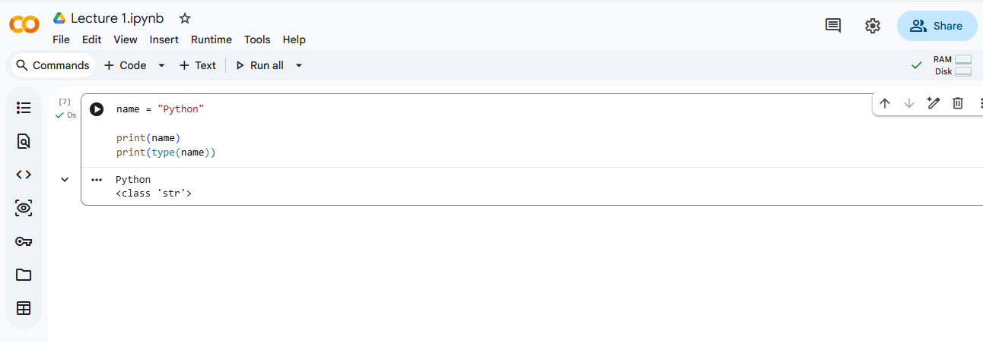
String (str) Data Type

Slide 54
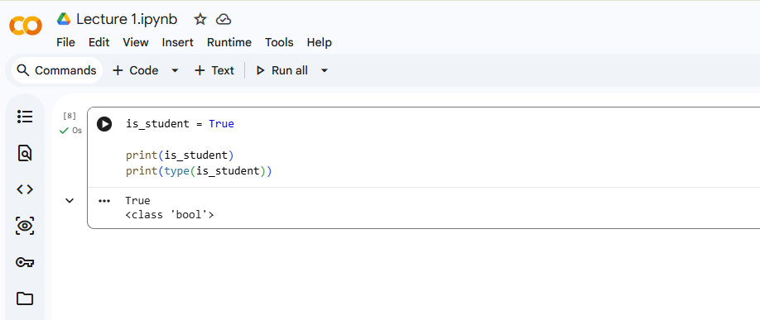
Boolean (bool) Data Type

Slide 55
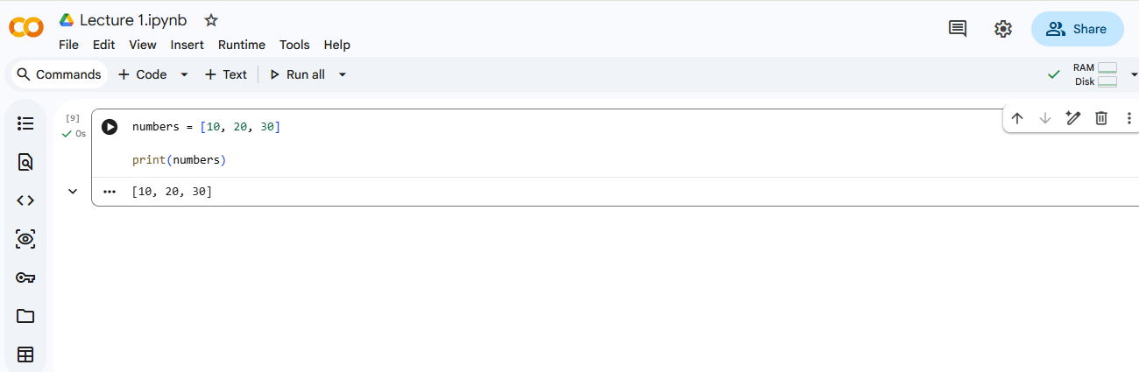
List Data Type

Slide 56
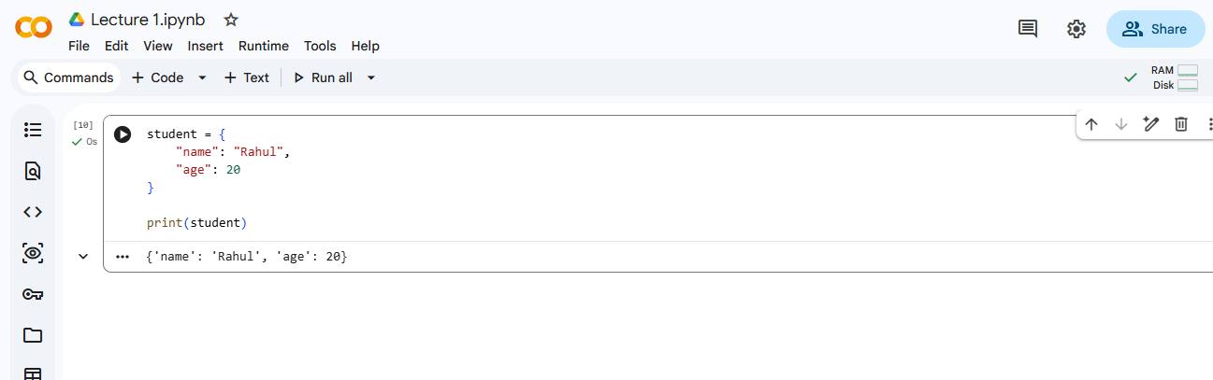
Dictionary Data Type

Slide 57
Exercise
Create variables for:
Integer value
Decimal value
String value
Boolean value
List

Slide 58
User Interaction in Python
User interaction allows users to provide input to a program.
Python uses the input() function for user interaction.
input() Function
Syntax
input("Message")
Displays a message to the user, Accepts input from keyboard and returns input as a string

Slide 59
Example 1 — Simple User Input
name = input("Enter your name: ")
print("Hello", name)
Type Conversion
input() stores data as string by default
To perform mathematical operations:
int() converts to integer
float() converts to decimal
Example 2 — Taking Numeric Input
age = int(input("Enter your age: "))
print("Your age is", age)

Slide 60
Example 3 — Addition Using User Input
a = int(input("Enter first number: "))
b = int(input("Enter second number: "))
print("Sum =", a + b)
Exercise
Create a program that:
Takes student name as input
Takes marks as input for 5 subjects
Displays the result of the student.

Slide 61
Assignment
Find area of rectangle.
Find simple interest.
Convert temperature from Celsius to Fahrenheit.
Calculate average of 3 numbers.
Find square and cube of a number.
Swap two numbers without third variable.
Create a Student Report Program that take student details using input(), Store marks in variables, Calculate total and percentage , Use comments, Use proper indentation

Slide 62
Thank you

